Slide 1
HW8 VER2 Presentation
Jacob Nelson

Slide 2
What you will find
-A robust time management system.
-A feature to add, and search data.

Slide 3

Feature 1 Time Format:
-This feature allows you to toggle time formats between AM/PM and 24 hour.

Slide 4
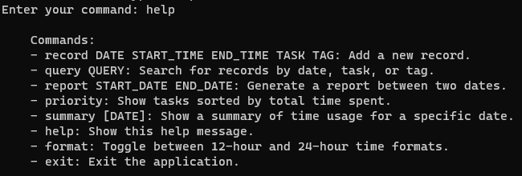
Feature 2 help command:
-This feature allows you to always find a list of commands to use.

Slide 5

Feature 3 Summary Command
-This feature allows you to see a summary of tasks occurring on a specific date.

Slide 6
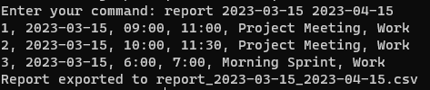
Feature 4 Report OUTPUT
-The report function outputs a CSV file.

Slide 7
Lines of Code
445 Lines of Code total

